Slide 1

Introductions
CENTRE ON AGING COLLOQUIUM SERIES
Optimizing Aging & Health: Methods & Applications
Scott M. Hofer
Andrea Piccinin, Graciela Muniz, Jeffrey Kaye, Diana Kuh, Sean Clouston, Daniel Mroczek and many IALSA/Maelstrom colleagues
The Integrative Analysis of Longitudinal Studies of Aging (IALSA; www.ialsa.org) research network is supported by a grant from the National Institutes of Health/NIA: 1P01AG043362; and previously by NIH/NIA 1R01AG026453 and the Canadian Institutes of Health Research: 200910MPA Canada-UK Aging Initiative.

Slide 2
Types of Large-Scale Data Resources
Integrative Data Analysis
Collaborative/Coordinated analysis of existing data resources
Biobanks (P3G; BioSHARE), longitudinal cohort studies (IALSA; HALCYON, CLOSER, DYNOPTA, COSMIC, etc.)
Embedded within Healthcare Infrastructure
Integrated Electronic Health Record as a platform for sustainable longitudinal and frequent measurements
Basis for learning health care system / precision medicine
E-Epi Research/Remote Objective Measurement
Optimize data acquisition across laboratory, clinical, and in-home settings
Longitudinal, detailed, and minimally obtrusive assessments

Slide 3

Integrative Analysis of Longitudinal Studies of Aging www.ialsa.org
The IALSA network (NIH/NIA 1P01AG043362) is comprised of over 100 longitudinal studies on aging, health and dementia.
Mix of samples aged from birth to 100 years, with birth cohorts ranging from 1880 to 1980.
Assessed from 1921 to the present.
Time between assessments ranges from 6 months to 17 years (the majority 1-5 years), with up to 32 (typically 3-5) measurement occasions spanning 4 to 48 years of monitoring within each individual.
Collaboration with UK Healthy Ageing across the Life Course (HALCyon) and the Quebec Network for Research on Aging.
Reproducibility of results (i.e., direction and pattern of effects) across populations, historical periods, measurements, designs, and statistical models.
Hofer & Piccinin, 2009; 2010; Piccinin & Hofer, 2008
Notes:
Maturity of data
Prior collaborations
Need for longitudinal WP results to inform aging research

Slide 4
Major research aim: To maintain and enhance cognitive and physical health and well-being throughout the lifespan
Detecting within-person change:
Why do these changes occur (e.g., health)? Can these changes be prevented, delayed, or treated?
Is this individual changing more rapidly than they have in the past?
Contextual and lifespan factors:
What is the impact of early life characteristics (e.g., childhood cognition; early life distress) and changing cohort contexts (e.g., SES, education, nutrition) on later life outcomes?
Within-person dynamics:
Improvements in within-person measurement and design to better predict future outcomes (e.g., frailty; dementia)

Slide 5
“Most Published Research Findings are False”
Ioannidis (2005); Young, Ioannidis, Al-Ubaydli (2008), www.PloSmedicine.org
Dramatic results are more likely to be false
Less dramatic results unpublished or in less prestigious journals
Why?
Competition for “original” contributions: Highly selected studies are overvalued and unrepresentative of true outcomes
Bias towards publishing positive results
Artificial scarcity; Best journals publish “most dramatic” research; excuse for rejection
Solution: Provide basis for demonstrating replicability
Science as an objective and open process
Data sharing and availability for re-analysis / extension of results
Availability of full results and methods, reasons for selective findings given
Publish all research that meets quality threshold

Slide 6
Longitudinal Observational Studies
Sources of Variation in Results
Measures and Measurement Models
Populations and samples (country, cohort)
Design Factors
Number, Spacing, and Duration of Observation
Age / Cohort / Period (i.e., baseline heterogeneity)
Selectivity / Incomplete Data
Retest Effects
Statistical Models (change, covariate adjustment)
Emphasis on pattern of results (directionality)
Maxwell (2012); West & Thoemmes (2010): “This variation may typically be of only minimal scientific or policy interest, except when the reversal or the elimination of a causal effect occurs.”

Slide 7
Integrative Data Analysis: Systematic Study of Testable Hypotheses
Cross-Method
Sensitivity of results to design (e.g., different confounds) and analysis (e.g., different models of change)
Cross-Cohort (Between-Group)
Changing outcomes and influences, critical periods
Cross-Country (Between-Group)
Natural experiments: diffs in secular trends and policies
Long-term longitudinal (Within-Person)
Cognitive reserve (childhood IQ; educ), impact of early and middle life predictors, detection of indiv. change-points
Prediction
Extrapolation to prospective studies / recent birth cohorts

Slide 8


Slide 9
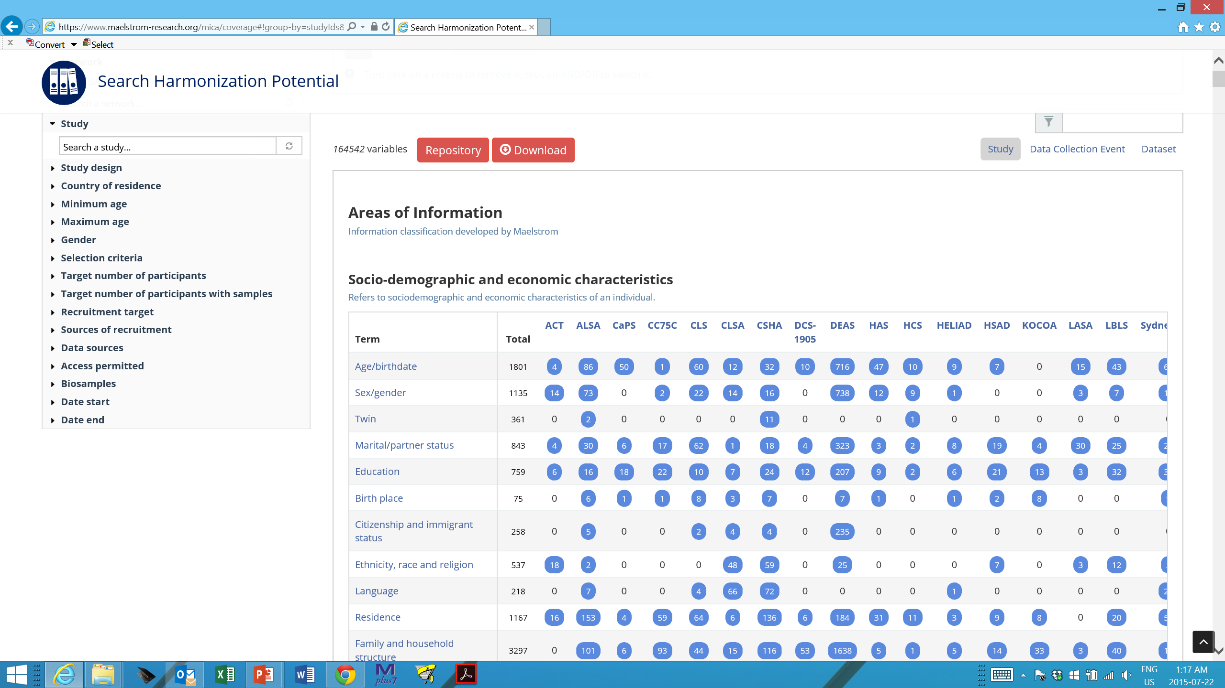
Maelstrom-IALSA Metadata Catalogue and Harmonization Platform https://www.maelstrom-research.org/mica/network/ialsa

Slide 10
IALSA Approach: Reproducibility
Coordinated/Parallel analysis
Aim: To maximize the data value from each study while making results as comparable as possible
Expect similar conclusions regardless of the exact variables used.
Construct-level comparison
Common statistical models
Emphasis on cross-culture, cross-study comparisons
Evaluation of sensitivity to statistical model
Meta-Analysis / Meta-Regression
Evaluation of subgroup interactions (e.g., age) across studies
Hofer & Piccinin, 2009, Psychological Methods

Slide 11
IALSA Portland Workshop Feb. 23-25, 2015
Primary aim: To examine associations between changes in physical functioning (i.e., grip strength, pulmonary function, chair stands, walking speed) and cognitive functioning (i.e., measures of speed, memory, reasoning, executive functioning) in multiple-study comparative framework.
Pulmonary function – Cognition
Grip Strength – Cognition
Gait – Cognition
Cognition: Within and across cognitive domains
Physical functioning: Across pulmonary, grip, gait
Bivariate linear growth curve models
Adjustment for age, sex, education, height, health behaviors, and health outcomes in block sets.

Slide 12
Coordinated Analysis: Studies
Study | Contact
Einstein Aging Study | Andrea Zammit
English Longitudinal Study of Aging | Annie Robitaille
HRS | Chenkai Wu
Interdisciplinary Longitudinal Study | Philipp Handschuh
Normative Aging Study | Lewina Lee
NuAge | Valerie Jarry
OCTO-Twin | Marcus Praetorius
Rush Memory and Aging Project | Cassandra Brown
SATSA | Deborah Finkel

Slide 13


Slide 14
IALSA Analysis Workshops
NACC/IALSA Methodological issues in analysis of natural history cohorts (Sept 2015)
Harmonization Summit (Spring 2016; June 2017)
IALSA Analysis Workshops (Fall 2015/Spring 2016)
Selection into retirement and impact of retirement on cognitive and physical functioning and health (Gothenburg, October 2015)
Impact of secular changes (i.e., Flynn effect) on age-based estimates of cognitive and physical level and change in functioning
Predictive models for use in prospective studies: Dynamic risk profiles and joint modeling of dementia and death
Incorporating terminal decline in models of aging
Evaluation of models for successful/healthy/active aging

Slide 15


Visual tools for big analyses:
Cross-study replication of bivariate growth models
Andriy Koval ( UVic)
Cassandra Brown (UVic)
William Beasley (OU)
CENTRE ON AGING COLLOQUIUM SERIES
Optimizing Aging & Health: Methods & Applications
13-October-2015

Slide 16
Overview
Scott (5-7 mins)
Big picture of Portland. Why many studies?
Andrey(10-15 mins)
How can we organize the workflow?
Will (5-10 mins)
How can we optimize the workflow?
Andrey(5-7 mins)
What can we learn so far? 5D, BISER, Forest
Cassandra (30-40 mins)
How can we use all this to explore specific questions? (varying wave count RADC study)

Slide 18
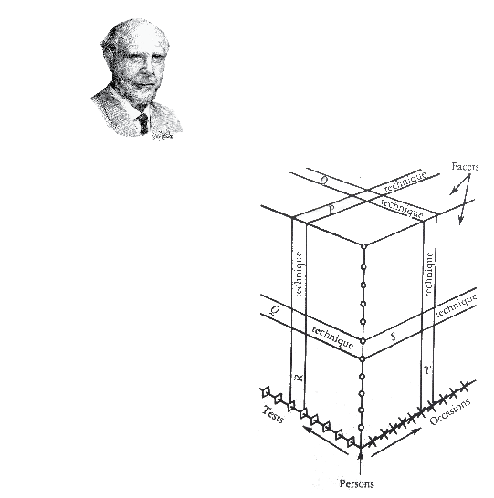

Slide 19
ELSA
HRS
ILSE
SATSA
EAS
NuAge
RADC
LASA
OCTO

Slide 21
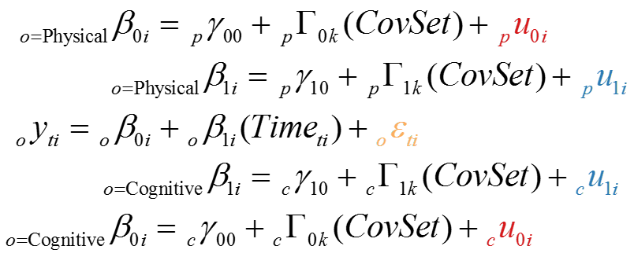
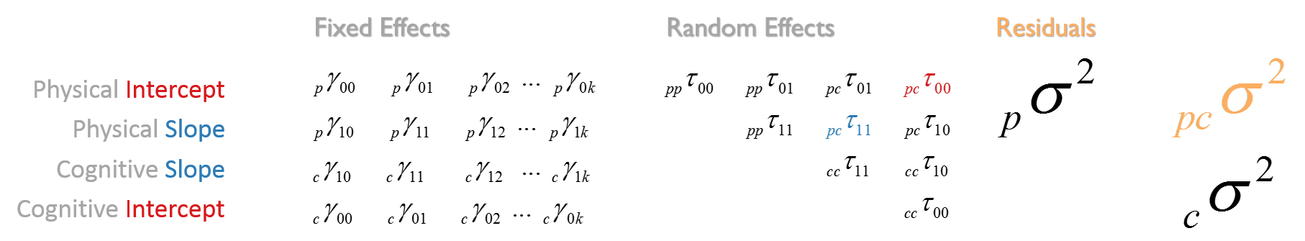

Slide 23
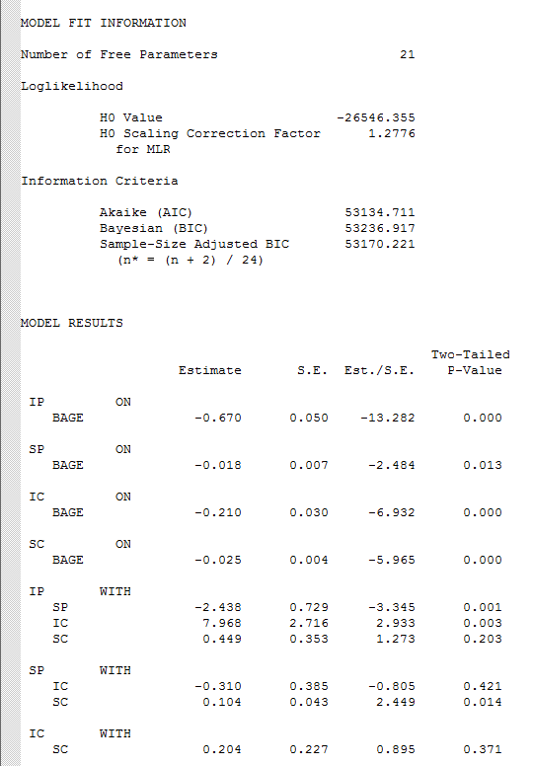

Slide 25
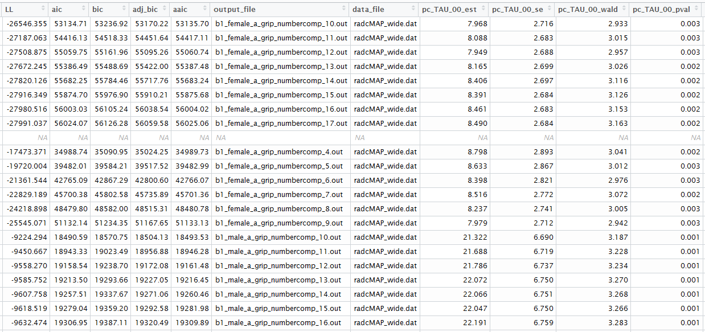

Slide 26
New units : models
Dimensions/variables
Subgroup:
Process1: grip, gait, fev, etc.
Process2: mmse, word recall, number comparison
Covariate Set: age, height, education, smoking
Study: ELSA, SATSA, HRS

Slide 27
Exploratory Graphical Devices
See more at
github.com/IALSA/IALSA-2015-Portland
Google terms: github ialsa portland

Slide 28
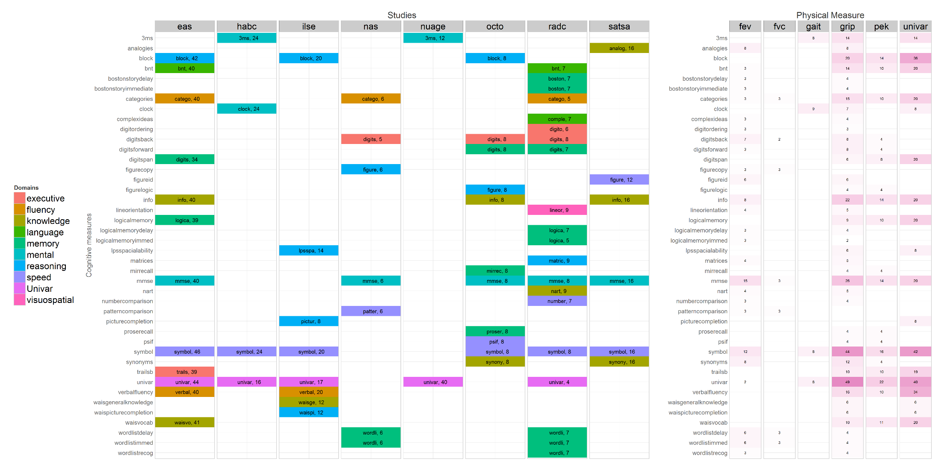

Slide 31
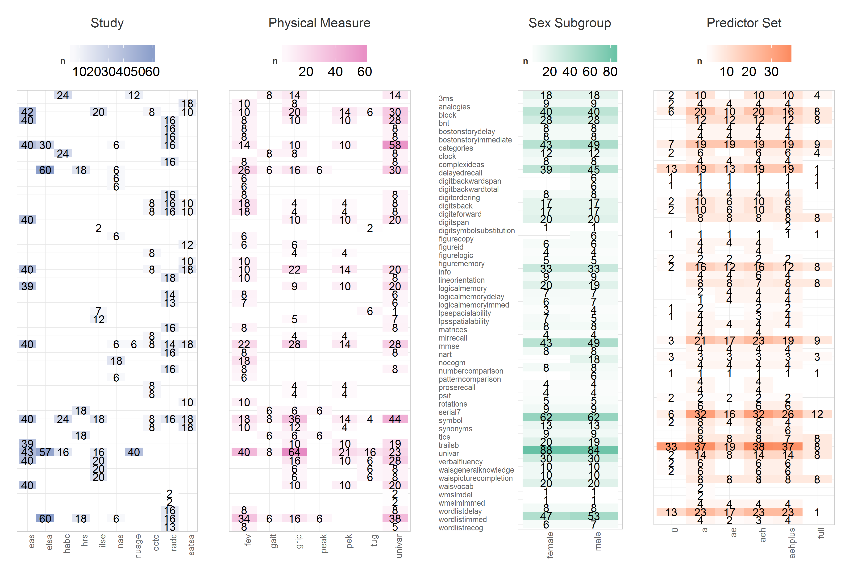

Slide 32
…
…
…
…
…
…
How can we optimize the workflow across studies?

Slide 33
…
…
…
…
…
…
Pre-Conference Survey
Catalog
IalsaSynthesis
Reports
Goal of these four steps: automate many menial tasks
Have more fun.
Produce fewer errors.
Complete faster.
Address more ambitious research questions.
Notes:
We start with many possibilities for analysis in each study, as each may contain unique set of measures.
PRECONFERENCE SURVEY collects information about the measures in each study
And enumerates a list of (bivariate) modes that humans will use to implement the objectives of the conference

Slide 34
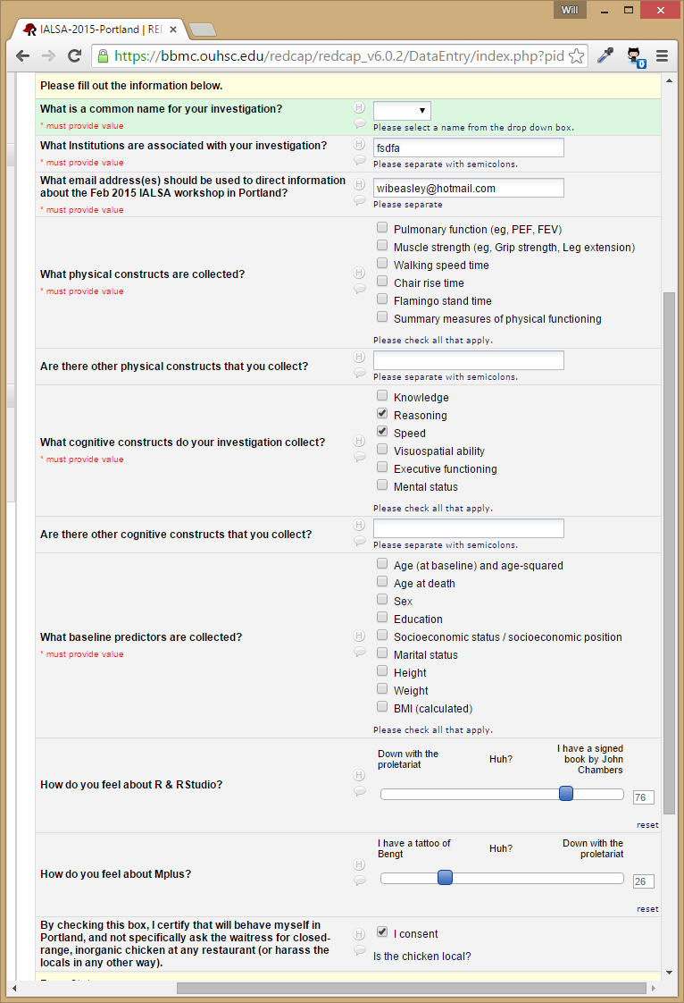
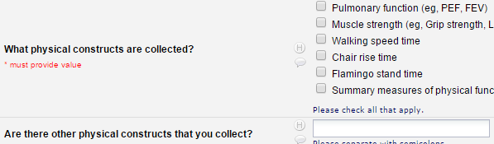
Pre-Conference Survey Example
Notes:
Each study responds with their available measures that could contribute to a meta-analysis. Here’s a pre-conference survey demo (with simplified items so it will fit on a page).

Slide 35
…
…
…
…
…
…
Pre-Conference Survey
Catalog
IalsaSynthesis
Reports
Notes:
REDCap prject,
Starts off as a to-do list for the modelers to follow, the roadmap of the conference
Develops into a collector of results

Slide 36
…
…
…
…
…
…
Pre-Conference Survey
Catalog
IalsaSynthesis
Reports

Slide 37
…
…
…
…
…
…
Pre-Conference Survey
Catalog
IalsaSynthesis
Reports
within
study
across
studies
A1
A2
progress
B1
B2
analysis
Example of A1, A2

Slide 38
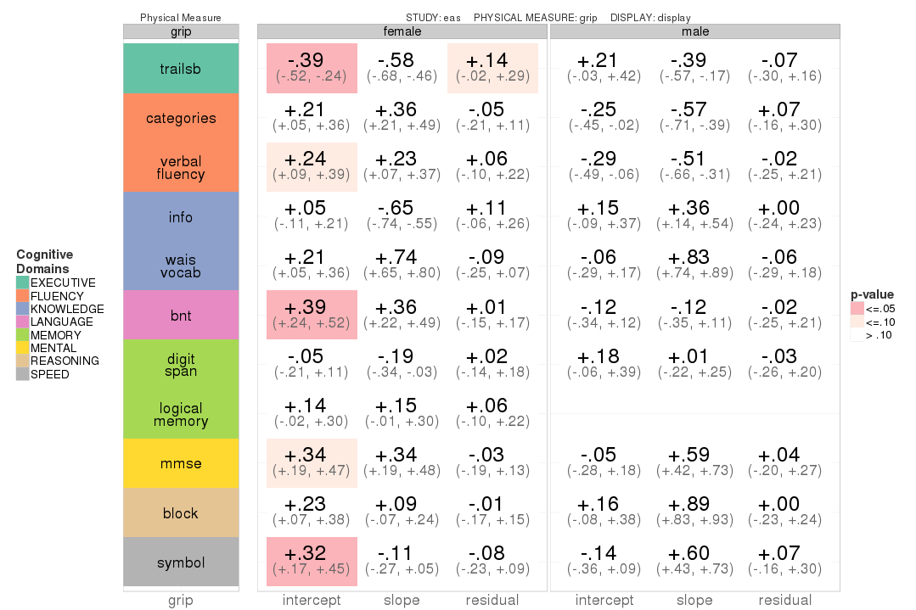

Slide 39
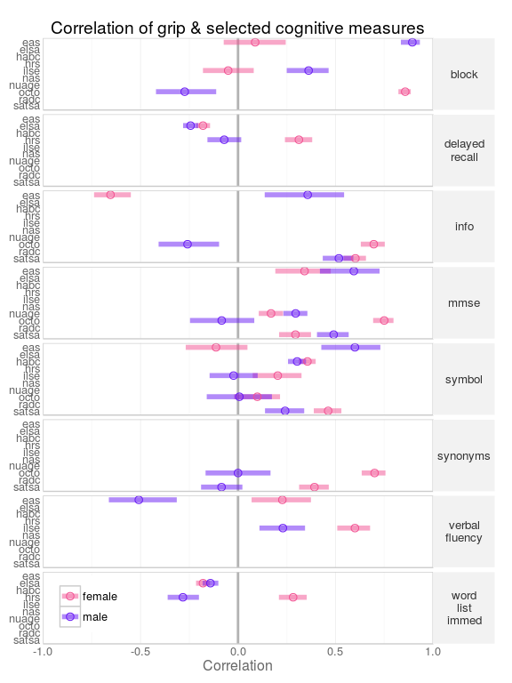

Slide 40
RADC: Extending wave counts
Rush MAP study
Began in 1997, rolling enrollment
Northeastern Illinois, residents of continuous care communities
Up to 17 waves of data, few people actually have this number
Decision about how many waves to include
Notes:
Working RUSH Memory and Aging Project study data as part an IALSA project examining concurrent change in measures of physical and cognitive ability over time. Because only one person actually had 17 years of data the models. Information is not available for all partipants at each wave

Slide 41
Participants
Follow up year
 | Women | Men
0 | 961 | 336
1 | 850 | 280
2 | 724 | 234
3 | 598 | 196
4 | 486 | 166
5 | 386 | 126
6 | 338 | 109
7 | 283 | 88
8 | 233 | 77
9 | 180 | 54
10 | 121 | 39
11 | 63 | 19
12 | 32 | 5
13 | 23 | 2
14 | 17 | 2
15 | 13 | 2
16 | 1 | 0
Notes:
The number of participants for whom the data is available at this time point.

Slide 42
Question
Do the number of waves included in the growth model impact the conclusions?
Examine cognitive and physical outcomes with increasing numbers of waves included
Notes:
Bivariate growth models simultaneously model trajectories for two dependent variables separately, but also allow the correlations between both intercept (baseline level) and slope parameters (change over time) of both variables to be examined.

Slide 43
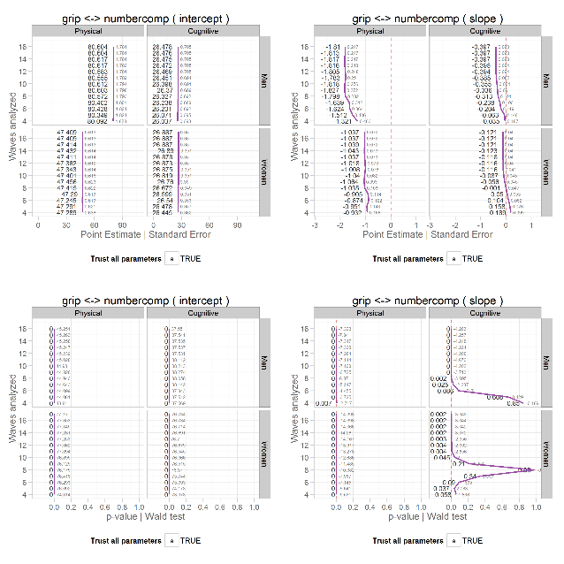
Plots
KB profiles
Left column: Intercepts (baseline)
Right column: Slope (rate of change)
Vertical facet: Gender
Horizontal facet: Outcome measures
X-axis: Numerical value
Y-axis: Waves included in analysis
Labels: Estimate|S.E.|Est./S.E. |P-Value

Slide 44
Intercepts
Intercepts show little change over the number of waves used in the analysis.
Across all outcome pairs this remains true
Intercepts are the baseline levels of the outcome measure
Fluctuations over the number of waves might indicate model misspecification

Slide 45
Grip-Category Fluency
Slope column, physical facet
Regardless of the number of waves analyzed we see a steady decline in grip strength for both sexes.
Women: The straight vertical purple line suggests a consistent rate of decline regardless of waves count included.
Men: The curvature of the line between wave count 4 and 8 hints at an accelerated rate of decline between those time points.
Notes:
Women: at a rate of about 1 unit decrease per unit of time (1 lbs of grip pressure per year).
Men: start a rate of decline of about 1.3 pounds per year, then this increases to almost 2 lbs loss of grip pressure per year.

Slide 46
Grip-Category Fluency
Slope column, significance row, cognitive facet
Slopes become significant once at least 9-10 waves are included
If we analyze fewer than 9 waves of data we fail to detect a significant decline in category fluency test performance.
Men require fewer waves (9) of data in the analysis to detect a significant decline than women (10).
Notes:
If we analyze fewer than 9 waves of data we fail to detect a significant decline in category fluency test performance.
However, category fluency shows a non-significant positive slope and then a non-significant negative slope until 9 waves of data are included for men and 10 waves of data are included for women. This also suggests that if you had 9 wave of data for men and women you would reach the conclusion that men are declining it category fluency performance but women are not over time, controlling for baseline age.

Slide 47
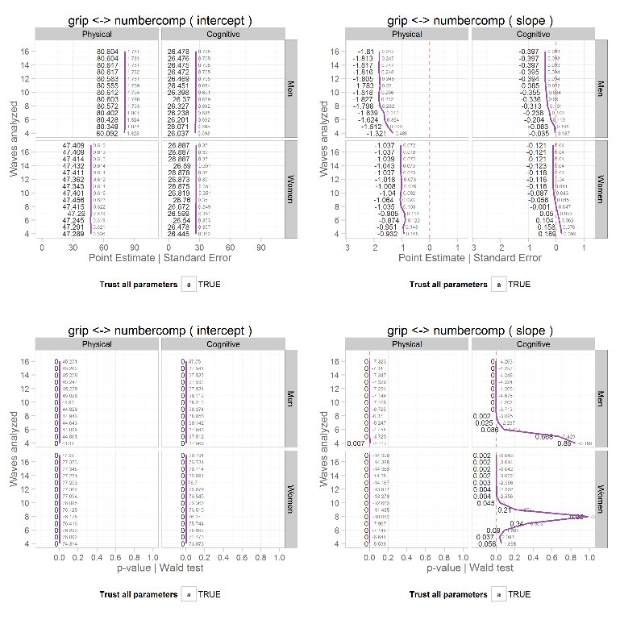
Grip-
Number Comparison
KB fans
Slope column, significance, cognitive facet
Men: We can detect a significant decline in number comparison task performance once at least 7 waves are included.
Women: Both positive (wave 5) and negative slopes (wave 9+) reached significance.
Notes:
Now we will move to a different album. Slopes were significant at

Slide 48
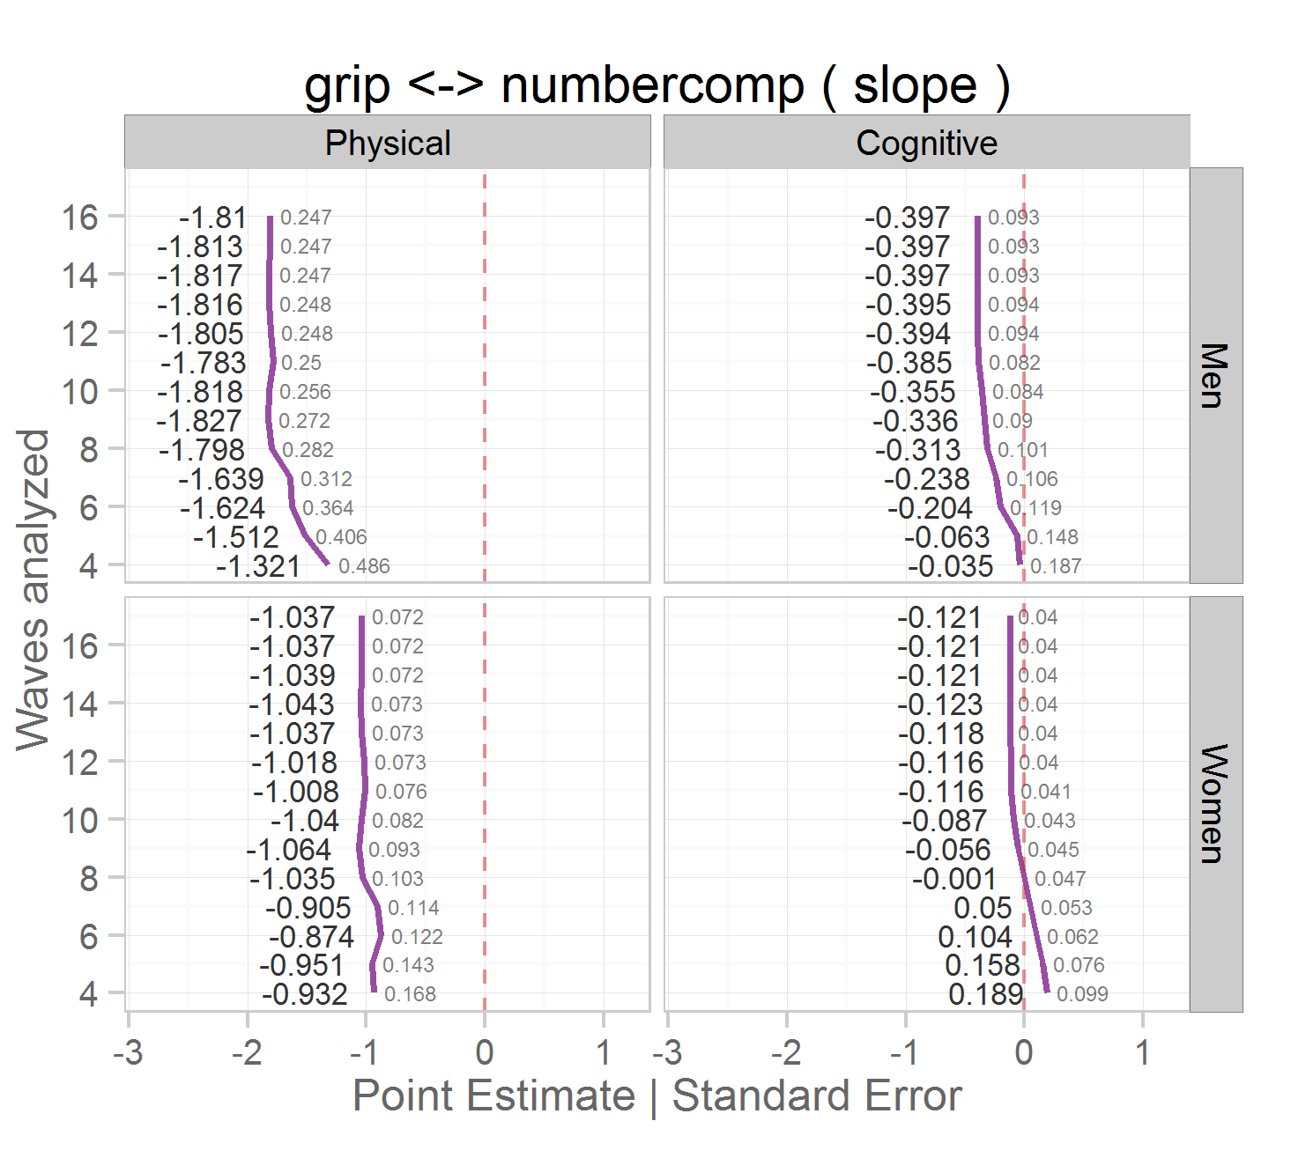
Grip-
Number Comparison
Zoom on top right cell
Facets: cognitive, women.
Changing signs of the slope suggests non-linearity in the observed data.
We explore the observed and modeled data in the next series of dynamic plots.
Notes:
Now we will move to a different album. For men the slope is negative regardless of the number of waves of data included but the decline in number comparison performance does not become significant until at least 7 waves are included.

Slide 49
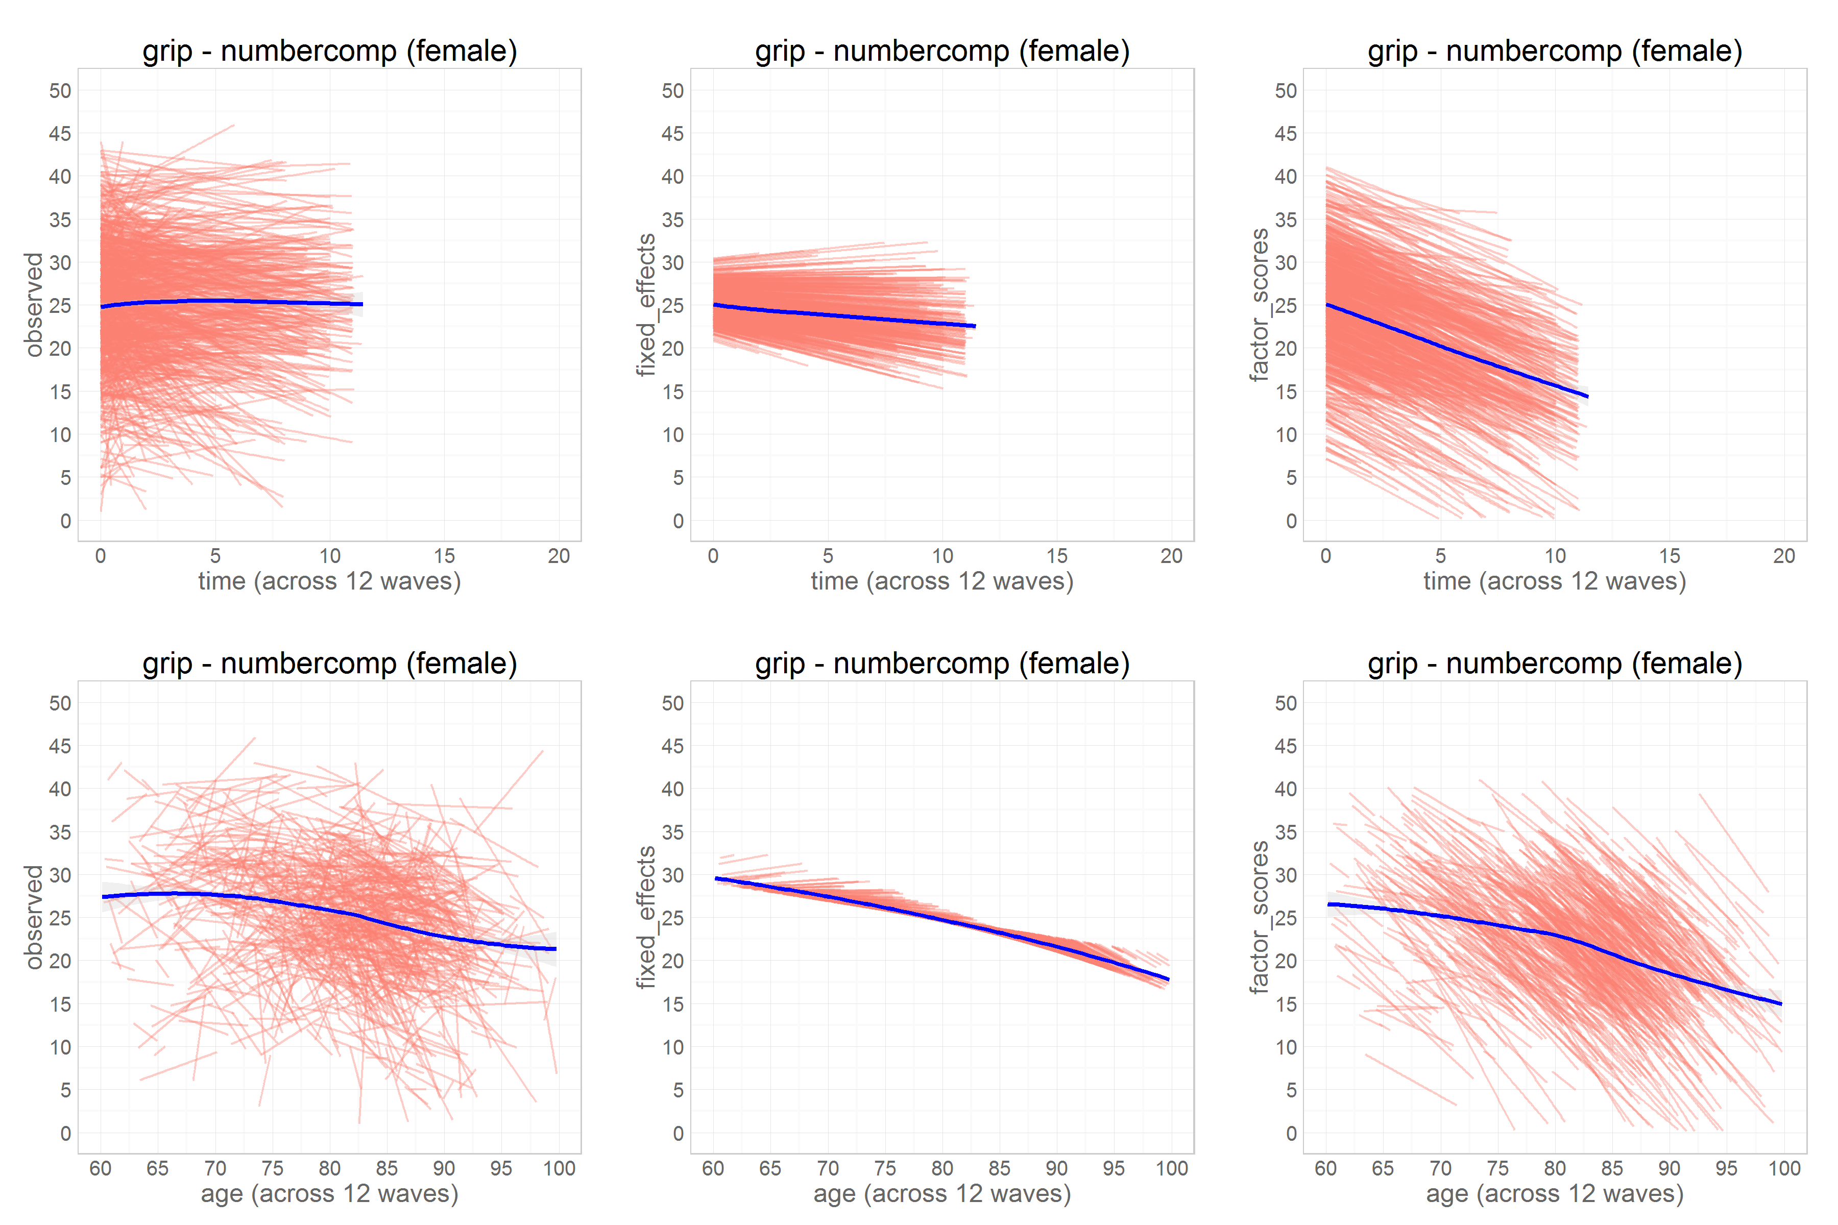
Kb Fans: grip-NUMBERCOMP
Red lines: trajectories of individuals across time.
Y-axis: performance on the number comparison task
X-axis: time metric
Top row: time in study*
Bottom row: biological age
Blue lines: smooth average
Notes:
Note that this is number comparison only.
*Time in study, controlling for baseline age was used in model estimate.

Slide 50
Kb Fans: grip-NUMBERCOMP
Left column: observed trajectories
Middle column: predicted trajectories reconstructed from the fixed effects (.out files) estimated by Mplus.
Right column: trajectories reconstructed from factor scores (gh5. file) created during model estimation in Mplus.
Notes:
Note that this is number comparison only.
*Time in study, controlling for baseline age was used in model estimate.
Predicted trajectories calculated from the Mplus *.out files containing the fixed effects (slope, intercept, the two coefficients of age on slope and intercept). These are predictions for every person of that age in the sample. If they have the same age and same time in study as another participant they would be predicted to have the same trajectory on this graph.
Right column: When we run the model the model spits out two things one of them is the .out file and the other is the .gh5 files. Now we are getting the gh5 file which retains the exact observations that are used in modeling and also contains things called factor scores because it considers each individual person as a factor. These are reported in the gh5. files. This is where we are a little unsure what we are talking about.

Slide 51
Kb Fans: grip-NUMBERCOMP
Left, age
The curvilinear shape of the trajectory is evident
Supports our hypothesis from Kb profile graph
Small increase in performance between ages and 60 and 65 likely represent practice effects
Decline begins ~67 yrs
Accelerates ~82 yrs
Notes:
Violation of the linearity assumption

Slide 52
Kb Fans: grip-NUMBERCOMP
Middle, age
The blue line (smoothed average) becomes steeper as more waves are included in the analysis.
It appears that women show a practice effect but decline sooner (~67)
Men do not show a practice effect but decline later (~80)
There are fewer men than women
Notes:
Hypothesis: Before 82 you can exhibit training effects or steady progression but around 82 the learning effect does not compensate for deterioration.
If we don’t observe participants for enough waves we see the learning effect of increasing number comparison performance but do not detect the decline.

Slide 53
Kb Fans: grip-NUMBERCOMP
Right
Trajectories reconstructed from the estimated factor scores (Mplus .gh5 file)

Slide 54
Questions/Discussion
Q1: What exactly do factor scores reconstruct?
Q2: At what wave count do trajectories become unreliable?

